Slide 1
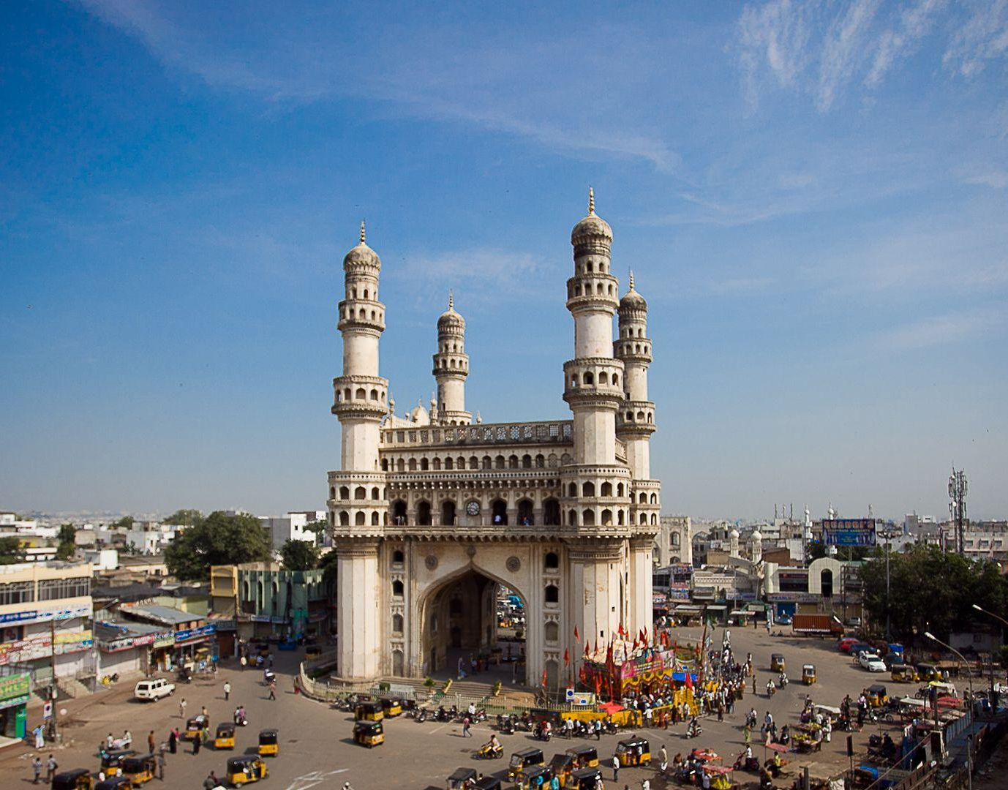



Telangana's Growth Analysis
Codebasics Resume Project Challenge Seven
In Collaboration with Government of Telangana

Slide 2

Objectives
Analyze document and E-Stamp registrations' volume and value across 33 districts.
Identify seasonal or cyclical patterns in registration revenues.
Evaluate vehicle sales trends by fuel type and vehicle class, considering district-level preferences.
Analyze sectors with substantial investment and their economic impact, assessing the effectiveness of district-specific investments.

Slide 3

Tools Used
Analysis : Microsoft Power BI,MySQL
Visualization : Microsoft Power BI
Presentation and Design : Microsoft Powerpoint

Slide 4

About Telangana
Telangana, the youngest state of India was established on 2nd June, 2014
One of the fastest growing states with significant economic development
Focuses on infrastructure, IT, agriculture, education, healthcare and pharmaceuticals
One of the Indian state with an open data policy

Slide 5


Stamp Registration

Slide 6
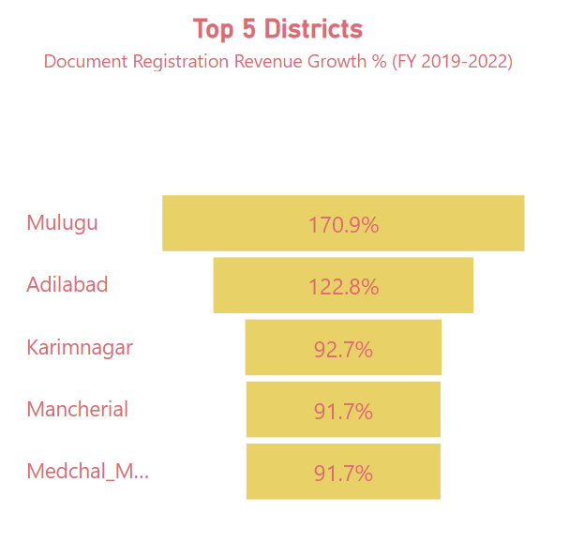
1. How does the revenue generated from document registration vary across districts in Telangana? List down the top 5 districts that showed the highest document registration revenue growth between FY 2019 and 2022.
The following are the top 5 districts with the highest document registration revenue:
Mulugu
Adilabad
Karimnagar
Mancherial
Medchal Malkajgiri
These districts reflect substantial document registration revenue, underscoring their robust economic vitality. They not only attract investments but also cultivate a business-friendly environment.

Slide 7
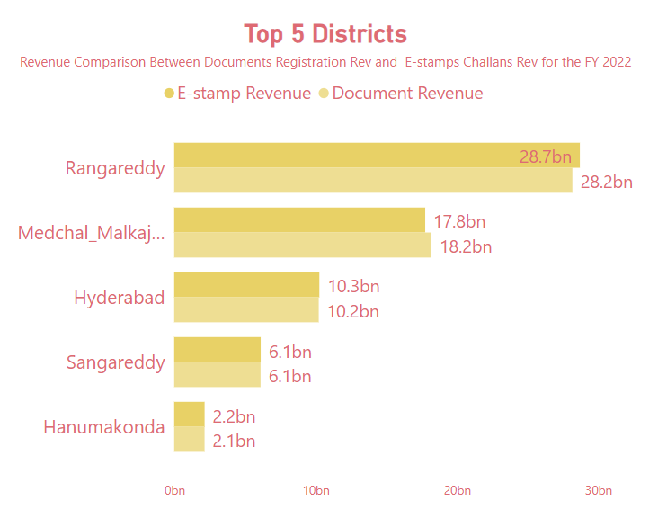
2. How does the revenue generated from document registration compare to the revenue generated from e-stamp challans across districts? List down the top 5 districts where e-stamps revenue contributes significantly more to the revenue than the documents in FY 2022?
These districts exhibit a significant surplus of E-Stamps revenue over document registration revenue due to factors like
Urbanization,
Population density,
Economic activity,
Digital literacy.

Slide 8
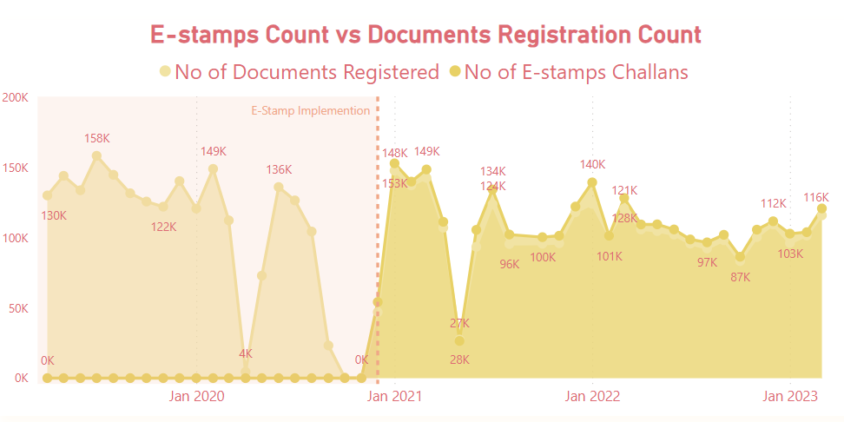
3. Is there any alteration of e-Stamp challan count and document registration count pattern since the implementation of e-Stamp challan? If so, what suggestions would you propose to the government?
E-stamp Challan was introduced in 2020.
It has been steadily growing in usage alongside traditional document registration methods.
The trend indicates a slightly higher preference for E-stamp Challan, reflecting increased acceptance among the public.

Slide 9
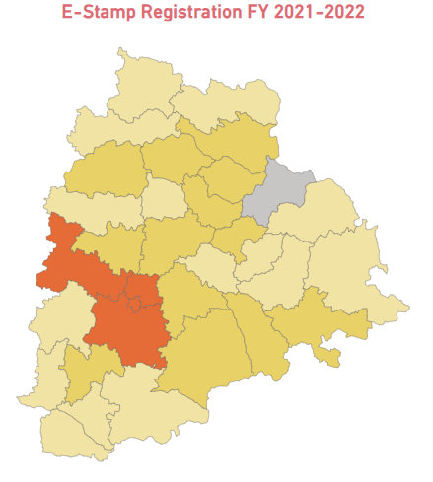
4. Categorize districts into three segments based on their stamp registration revenue generation during the fiscal year 2021 to 2022?
Top revenue districts : Sangareddy, Rangareddy, Medchal_Malkajgiri and Hyderabad
Mid revenue districts : Yadadri Bhuvanagiri, Suryapet, Siddipet, Nizamabad, Nalgonda, Mahabubnagar, Khammam, Karimnagar, Wanaparthy Medak, Mancherial
Low revenue districts • Warangal, Mahabubabad, Kamareddy, Jayashankar Bhupalpally, Jangoan, Jagtial , Adilabad
The top 5 districts collectively contribute approximately 81-82% to the total revenue from document registration and e-Stamp, amounting to around ₹7,000 to ₹8,700 Crores in FY 21 and 22.
Mid Revenue districts account for approximately 10-11% of the total revenue.
Low Revenue districts make up about 6-8% of the total revenue.

Slide 10
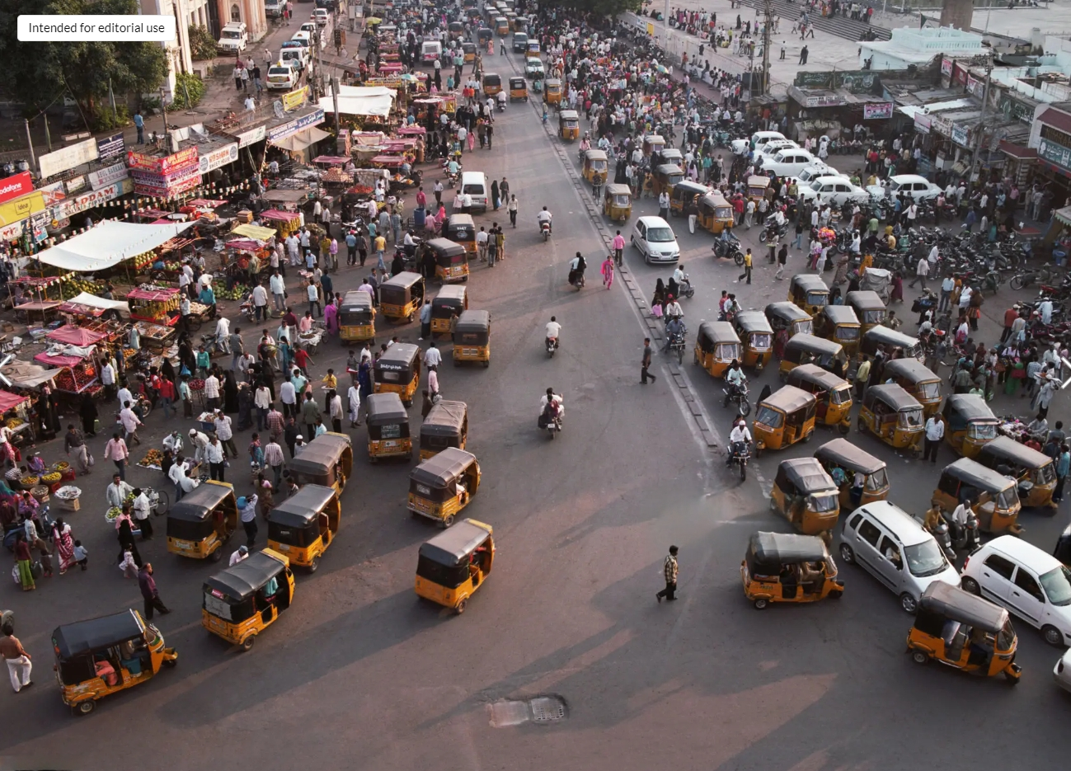
Transportation

Slide 11
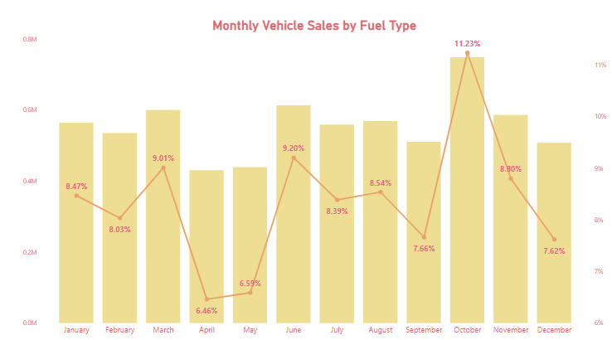
5. Investigate whether there is any correlation between vehicle sales and specific months or seasons in different districts. Are there any months or seasons that consistently show higher or lower sales rate, and if yes, what could be the driving factors? (Consider Fuel-Type category only)
October: Highest purchase rate at 11.23% of total sales.
Equivalent to a significant 748,000 unit sales.
Mainly due to the Diwali festival.
March: End of the financial year.
Witnessed higher sales, accounting for 9% of total purchases.
Driven by individuals and businesses seeking tax benefits.
June: Another month with a notable sales rate, constituting 9.2% of total purchases.

Slide 12
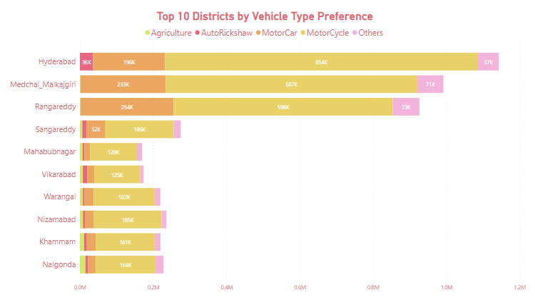
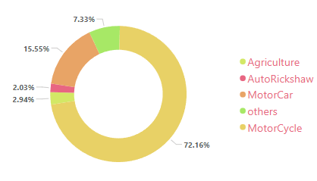
6. How does the distribution of vehicles vary by vehicle class (MotorCycle, MotorCar, AutoRickshaw, Agriculture) across different districts? Are there any districts with a predominant preference for a specific vehicle class? Consider FY 2022 for analysis.
FY 2022 Distribution of Vehicle Class:
Motorcycles constituted the majority at 72.16% of total vehicle sales.
Motorcars followed as the second most popular choice by 15.55%.
Predominant preference for motorcycles and motorcars observed in most districts.

Slide 13
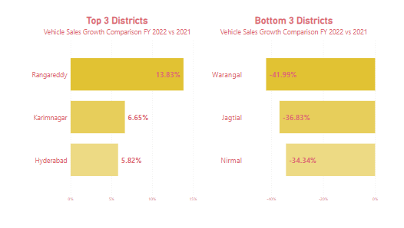
7. List down the top 3 and bottom 3 districts that have shown the highest and lowest vehicle sales growth during FY 2022 compared to FY 2021? (Consider and compare categories: Petrol, Diesel and Electric)
Top 3 Districts with Positive Sales Growth:
Ranagareddy
Karimnagar
Hyderabad
Bottom 3 Districts with Negative Sales Growth:
Warangal
Jagital
Nirmal

Slide 14
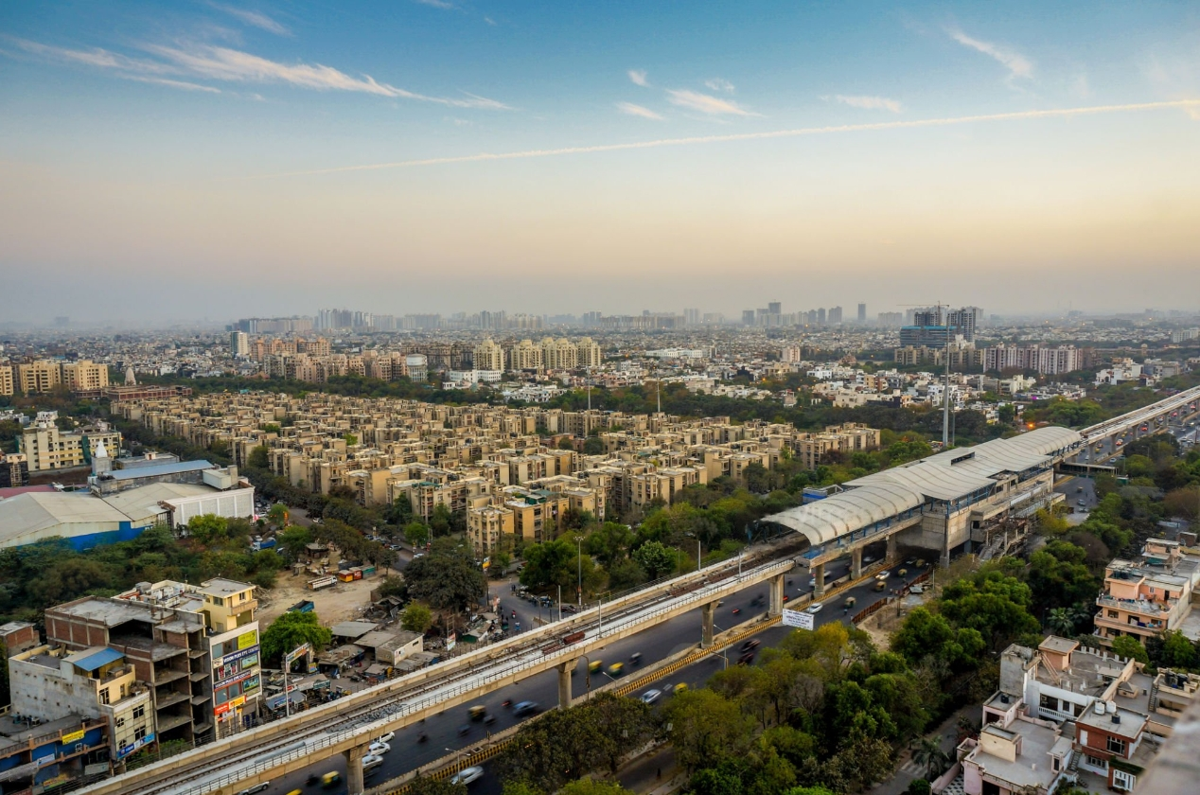
TS-Ipass
( Industrial Project Approval and Self-Certification System )

Slide 15
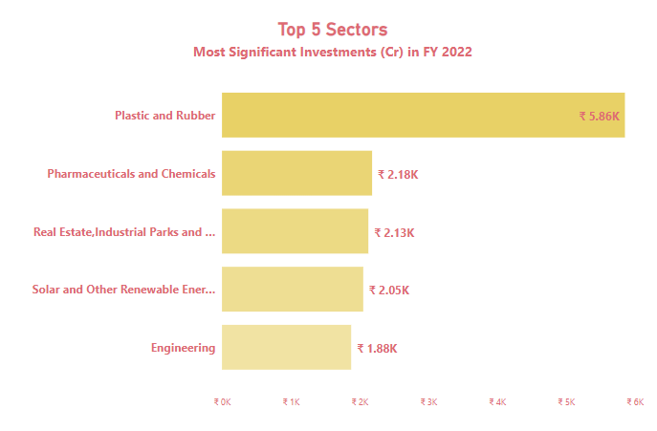
8. List down the top 5 sectors that have witnessed the most significant investments in FY 2022.
In FY 2022, top three investment-attracting districts: Rangareddy, Sangareddy, Medchal Malkajgiri.
Predominantly invested in sectors:
Plastic and Rubber
Pharmaceuticals and Chemicals
Real Estate (Industrial Parks & IT Buildings)
Solar and other Renewable Energy
Engineering

Slide 16
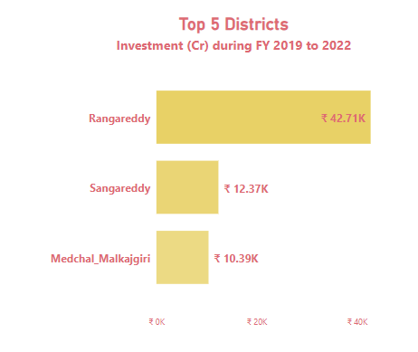
9. List down the top 3 districts that have attracted the most significant sector investments during FY 2019 to 2022? What factors could have led to the substantial investments in these particular districts?
Rangareddy, Sangareddy, and Medchal Malkajgiri consistently attracted 64% of total investments.
Key Investment Drivers:
Proximity to Hyderabad: Their closeness to Hyderabad, a major economic hub, is a significant factor.
Government Support: Proactive policies, incentives, and infrastructure initiatives foster industrial growth.
Infrastructure & Workforce: Well-developed infrastructure, skilled workforce, and proximity to transportation hubs boost investment attractiveness.
Logistics Hotspots: These districts serve as logistics and distribution hotspots due to their strategic location.

Slide 17
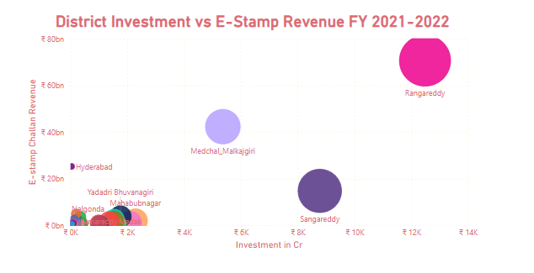
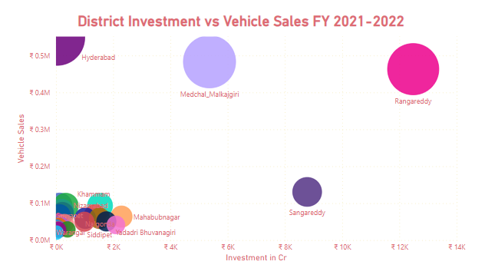
10. Is there any relationship between district investments, vehicles sales and stamps revenue within the same district between FY 2021 and 2022

Slide 18
Investment Impact: Rising investments directly correlate with an increase in document registrations.
Real Estate Momentum: A thriving real estate market acts as a catalyst, encouraging property investments, subsequently boosting stamp revenue.
Construction Activity: Increased construction activities, particularly in commercial and infrastructure projects, contribute to higher vehicle sales, particularly in the commercial and construction vehicle segments.
Economic Growth: Investment-driven document registrations reflect overall economic growth and vitality.
Policy Influence: Government policies can play a pivotal role in driving investments and, consequently, document registrations in specific sectors.

Slide 19
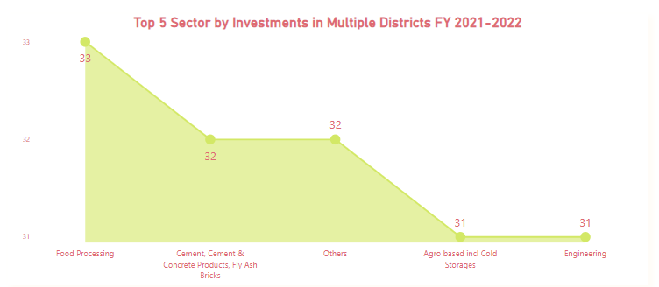
11.Are there any particular sectors that have shown substantial investment in multiple districts between FY 2021 and 2022?
Food Processing
Cement, Concrete & Fly Ash Bricks
Others
Agro Based inclusive Cold Storage
Engineering

Slide 20
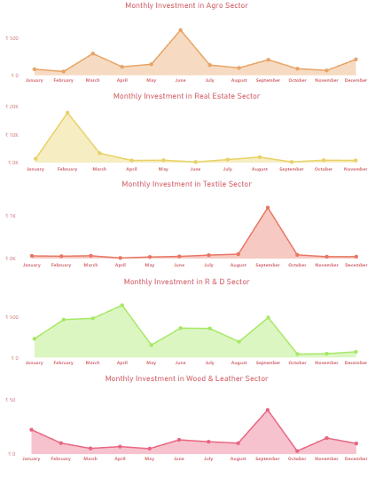
12.Can we identify any seasonal patterns or cyclicality in the investment trends for specific sectors? Do certain sectors experience higher investments during particular months?
June: Agriculture sector garnered the highest investments, with a 2-month shift.
February: Real Estate sector recorded its peak investments.
September: Textile sector saw maximum investments.
April and September: R & D sector attracted the most investments.
September: Wood & Leather sector received the highest investments.

Slide 21
Key Insights
E-Stamp Challan System Efficiency:
Implementation of the E-Stamp Challan system streamlined revenue collection and significantly boosted revenue generation.
This demonstrates the system's efficiency and highlights its potential for further financial growth.
Rise in Demand for Sustainable Transportation:
A remarkable surge in demand for electric vehicles (EVs) and alternative fuels like CNG and ethanol underscores the substantial investment and growth potential in the sustainable transportation sector.
This shift reflects a robust transition towards eco-friendly mobility solutions.
Consistent Growth Sectors:
Sectors such as Electrical and Electronic Products, Food Processing, Plastic and Rubber, and Research and Development have consistently demonstrated steady growth in investment.
Their sustained upward trajectory presents promising opportunities for ongoing expansion and economic development.

Slide 22
Key Insights
Key Growth Sectors with Employment Opportunities:
The top six sectors—Real Estate, Industrial Parks and IT Buildings, Pharmaceuticals and Chemicals, Engineering, Food Processing, Plastic and Rubber, and R&D—have not only exhibited remarkable growth but also offer significant job opportunities.
Their expansion fuels economic development while providing extensive employment prospects, playing a pivotal role in shaping a prosperous future.
Preference for Brand New Vehicles:
Notably, a significant 93% of total vehicle sales consist of brand new vehicles, indicating a strong market preference for new and freshly manufactured automobiles.

Slide 23
Recommendations :
Maximizing E-Stamp Challan System Adoption:
Offer incentives, conduct extensive awareness campaigns, and provide step-by-step guides to encourage wider adoption of the E-Stamp Challan system.
Implement a robust tracking application and introduce a chatbot for frequently asked questions (FAQs) to ensure quick and user-friendly assistance, thus promoting its usage.
Supporting Electric Vehicle (EV) Integration:
Proactively establish a comprehensive network of charging stations and develop necessary infrastructure to meet the growing demand for electric vehicles (EVs).
This strategic infrastructure investment is vital to ensure a seamless transition to EVs, fostering a sustainable and eco-friendly transportation ecosystem.

Slide 24
Recommendations :
Enhancing Business-Friendly Regulations:
Create a regulatory environment that is conducive to business growth by streamlining processes for permits, licenses, and approvals.
Promoting STEM Education and Digital Literacy:
Prioritize STEM (Science, Technology, Engineering, and Mathematics) education to align with the needs of evolving industries.
Promote digital literacy initiatives to bridge the digital skills gap and empower individuals for the digital age.

Slide 25
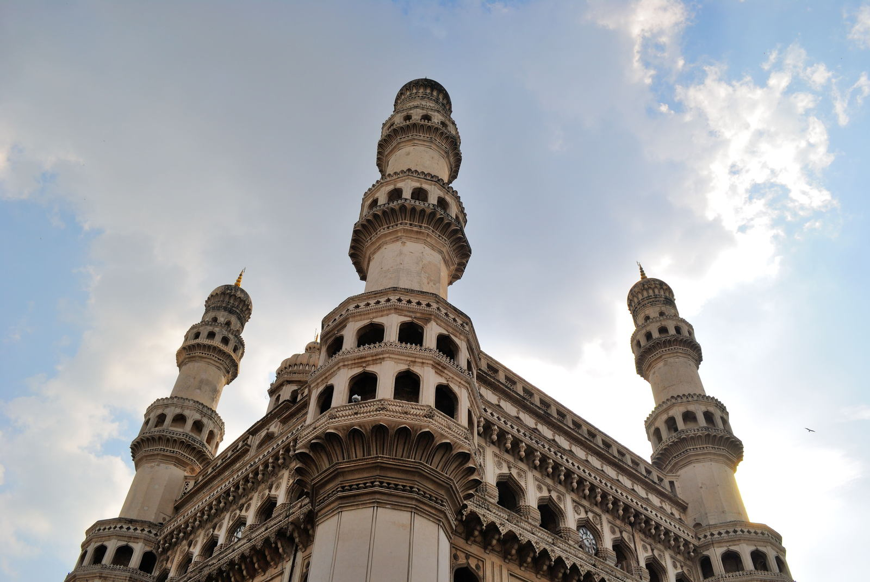
THANK YOU
Rashi Tiwari
tiwarirashi322@gmail.com

